Slide 1

Active Cloud
By,
Dayananda Saraswathi
Sirish Chandra
Manohar Reddy
Likitha

Slide 2
About
The application developed is an Android application which allows users to upload and download files to/from cloud storage.
The application solely uses Amazon Web Services for storage functionality.

Slide 3
Tools Used
IDE: Android Studio
Programming Language: Java
Operating System: Windows
Ram: 8GB
Android Version: 4.03(Ice Cream Sandwich and Above)
Android SDK version minimum :16 target :22
Storage Utility: Amazon Web Services( S3 Bucket)
Amazon Cognito services
Amazon Identity Access management

Slide 4
Features
Login Validation currently for single user since we haven’t provided any registration.
Uploading files from mobile device and facility to choose from phone storage or sd card.
Uploading files offline
Compression of files while uploading.
User controlled actions for uploading which include pausing the uploads , cancelling and deleting.
Automatically identifies if a user is trying to upload compressed file and skips compression.

Slide 5
Features Contd…
Simultaneous upload of files.
Ability to download files remotely.
User can choose to pause and cancel the download activity.
Compressed files will be automatically uncompressed while downloading.

Slide 6
File Upload Process
Android Mobile Device
Amazon AWS
IAM(Identity Access Management)
Amazon Cognito
Amazon S3 Bucket

Slide 7
File Download Process
Android Mobile Device
Amazon AWS
IAM(Identity Access Management)
Amazon Cognito
Amazon S3 Bucket
Cloud Folder in Mobile Downloads Section

Slide 8
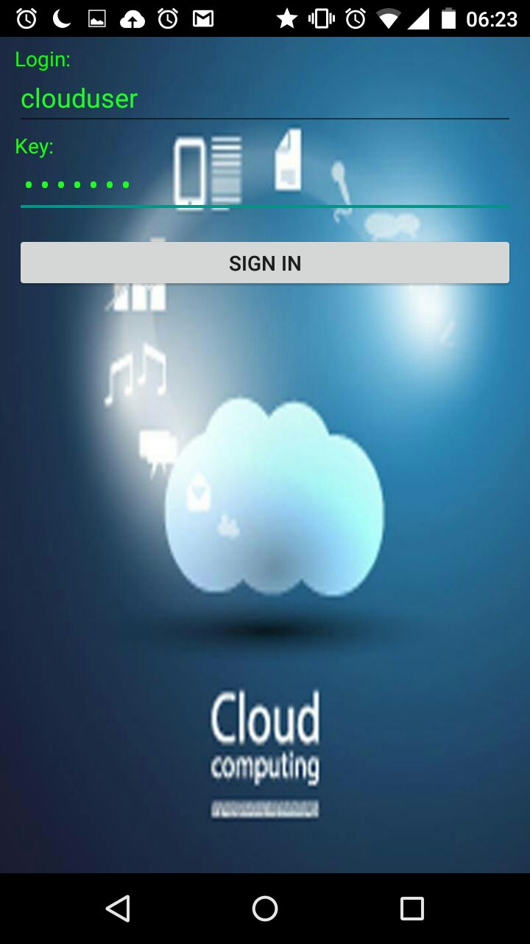
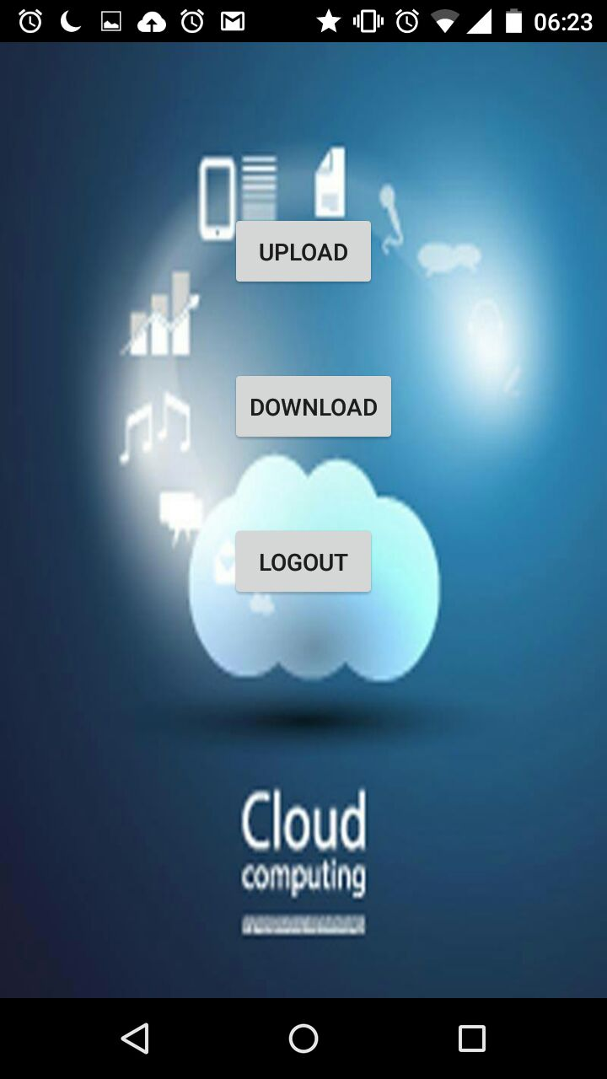
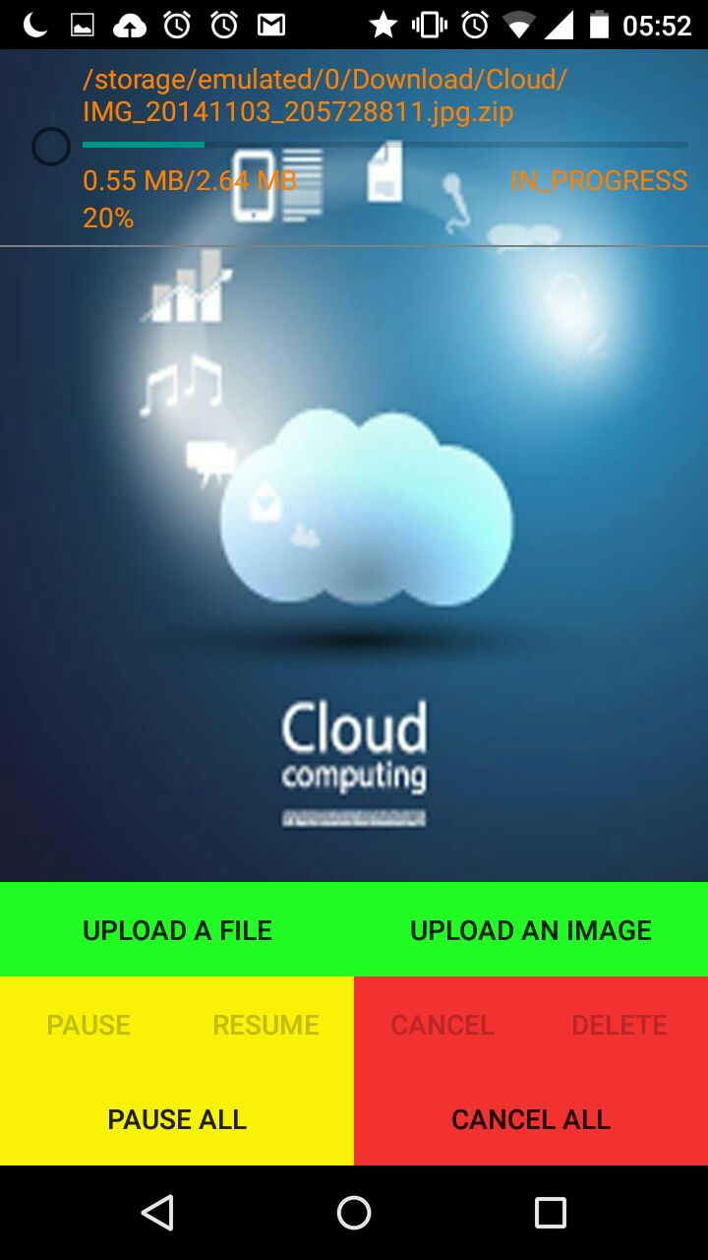
Screen Shots

Slide 9
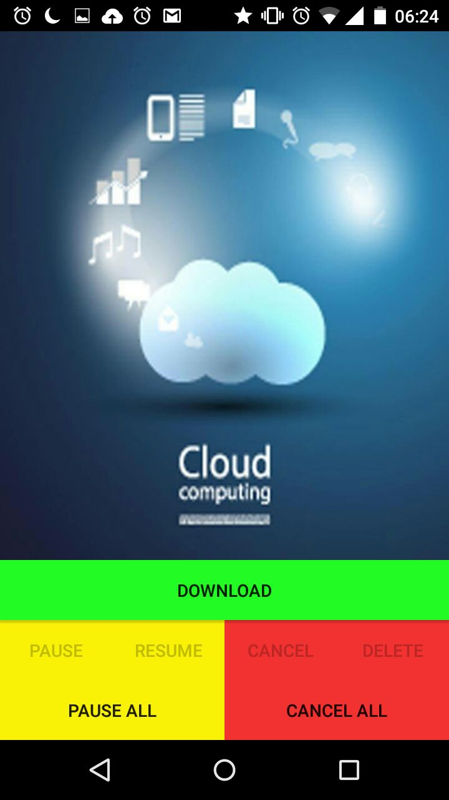
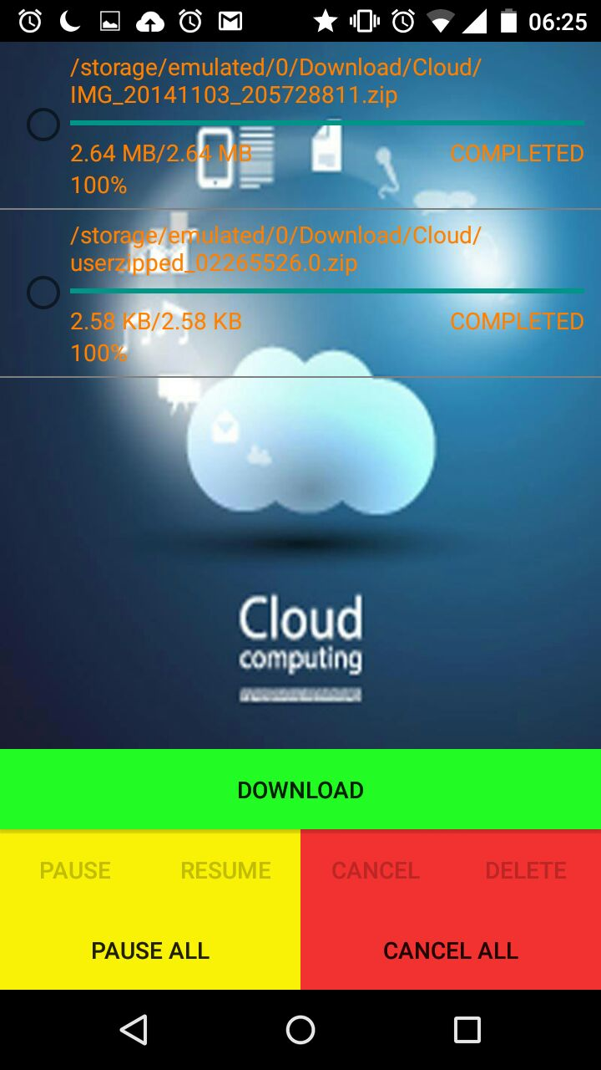
Screen Shots Contd..

Slide 10
Future Work
Integration of existing social network login information.
Usage of different compression techniques.
Usage of conventional databases for user login.
Adding data Encryption

Slide 11
Difficulties faced
Learning Android Studio.
Learning Amazon web services
Amazon web services configuration
Understanding the AWS SDK and Applying it to our android application
Integrating ZIP functionality.

Slide 12
Things Learned
Started using android studio and did our course project on it
Learned how AWS services work(AWS S3 bucket, cognito, Identity Access management, EC2 etc), and how to configure the services to our application
How to use Java Libraries in Android and integrating with our applications

Slide 13
Conclusion
The project gave us an opportunity to explore Amazon web services utility.
We also learned the challenges involved in developing and implementing cloud storage.
Comparing our application to the existing cloud storage applications the one thing that stands out is the file compression in all other clouds storage platforms you can upload compressed file but the native application doesn’t provide compression option.

Slide 14
Deploying Active Cloud Application in Android Studio
Open android studio
Go to file→ new → import project
Navigate to the location where you have the project file.

Slide 15
Reference
http://developer.android.com/training/index.html
http://developer.android.com/training/basics/firstapp/index.html
http://developer.android.com/training/basics/data-storage/index.html
http://docs.aws.amazon.com/mobile/sdkforandroid/developerguide/s3transferutility.html
Importing Android Project into Android Studio https://www.youtube.com/watch?v=nUuFuFLQ2bE

Slide 16
Thank You

